Slide 1
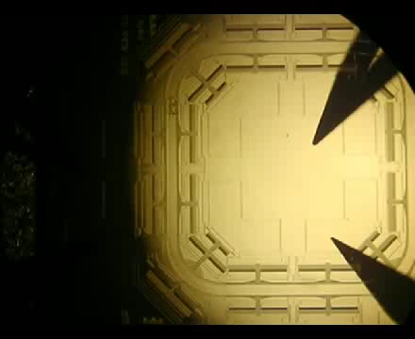
Micro Car based on MEMS electrostatic Actuator
The Micro transportation system based on MEMS electrostatic actuator. The micro car has a dimension of 0.2 mm x 0.03 mm (W x T). The 'road' system consists of straight, turning and T-junction modules.
D. V. Dao, P. H. Pham and S. Sugiyama, “Multi-Module Micro Transportation System Based on Electrostatic Comb-Drive Actuator and Ratchet Mechanism”, IEEE/ASME J. Microelectromechanical Systems (JMEMS), Vol.20/1, 140-149, (2011)

Slide 2
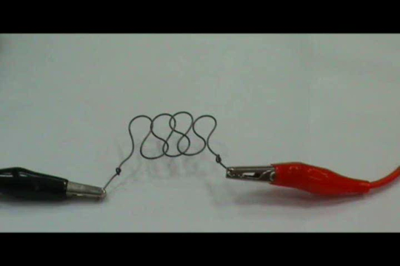
Resistive heating of NiTi Shape memory alloy wire

Slide 3
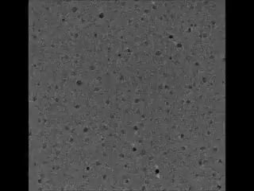
In situ transmission electron microscope (TEM) video (accelerated 10 times) of nucleation and self-organization of a high-density carbon nanotube network from catalytic iron nanoparticles, forming a vertically aligned forest.

Slide 4
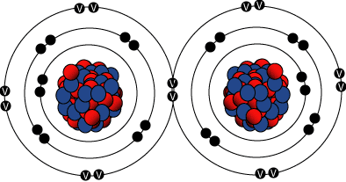
Clarification of the terms
Processing:
Casting route, Powder metallurgy route, Sintering, Doping, Vapor deposition
Thermal & Thermo-mechanical treatment (Forming): Forging, Rolling, Extrusion, Joining
Structutre: Arrangement of material’s internal components
Subatomic:
Atomic/ crystal
Microscopic
Macroscopic

Slide 5
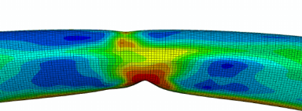
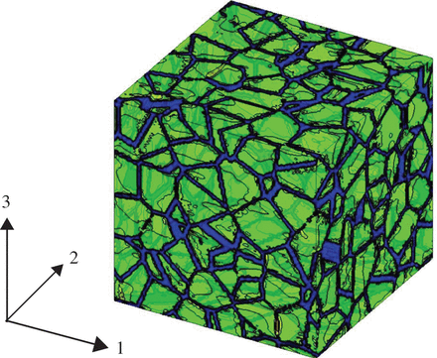
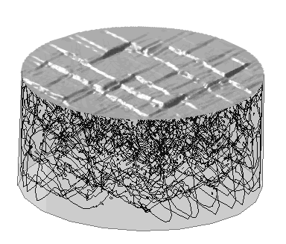
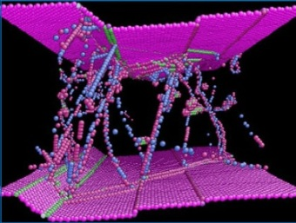
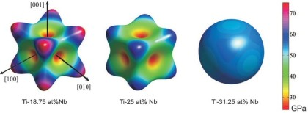
Paradigms of multiscalings
Length (m)
10⁻⁴
Continuum
10⁻⁶
Microstructure
10⁻⁸
Collective dynamics of defects
Structure & behavior of defects
10⁻¹⁰
Structure of matter
10⁻¹⁵
10⁻⁹
10⁻³
10³
Time (s)

Slide 6
Properties
Magnitude and Type of materials’ response to the
environment and external forces.
Mechanical
Electrical
Magnetic
Thermal
Optical
Chemical

Slide 7
Atomic Structure and Interatomic bonding

Slide 8
Recapitulate the following basic concepts yourself
Electron, Proton, Neutron – Masses and charges
Atomic mass/ weight (atomic mass unit)
Atomic number, Avogadro number, mole
Electrons in solids – Concepts of Classical mechanics vs. Quantum mechanics
Bohr atomic model -- Energy levels/ states
Wave mechanical model
Quantum numbers – Electron states (Values of energy that are permitted for electrons)
Pauli exclusion principle (The manner in which these states are filled with electrons) – Each electron state can hold no more than 2 electrons, which must have opposite spins
Electronic configuration
Ground state
Valence electrons (that occupy the outermost shell)

Slide 9
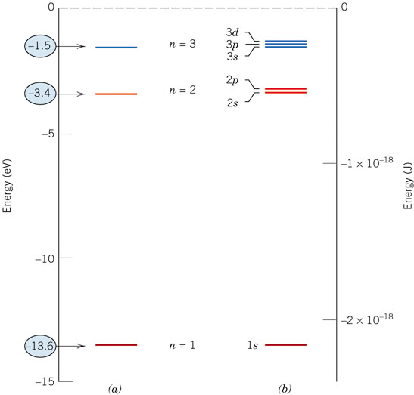
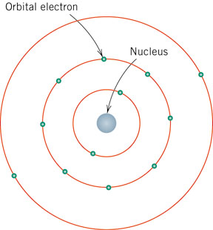
Recapitulate the electronic configurations of atoms from the book

Slide 10
Valence electrons determine all of the following properties
Chemical (stability/ chemical reaction/ atomic bonding)
Electrical
Thermal
Optical

Slide 11
Electronic Structure
Electrons have wavelike and particulate properties.
This means that electrons are in orbitals defined by a probability.
Each orbital at discrete energy level determined by quantum numbers. Quantum # Designation
n = principal (energy level-shell) K, L, M, N, O (1, 2, 3, etc.)
l = subsidiary (subshell) s, p, d, f (0, 1, 2, 3,…, n -1)
m_{l} = magnetic 1, 3, 5, 7 (-l to +l)
m_{s} = spin orientation ½, -½
Related to
Position of an electron
Shape of the subshell
# of energy states for each subshell
Spin moment of an electron

Slide 12
Electron Energy States
Electrons...
• have discrete energy states
• tend to occupy lowest available energy state.
4d
4p
N-shell n = 4
3d
4s
Energy
3p
M-shell n = 3
3s
Adapted from Fig. 2.4, Callister 7e.
2p
L-shell n = 2
2s
1s
K-shell n = 1

Slide 13
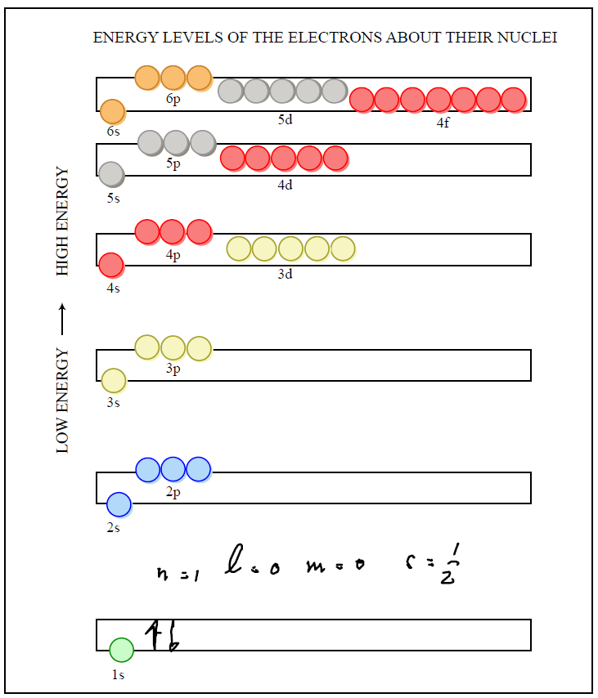

Slide 14
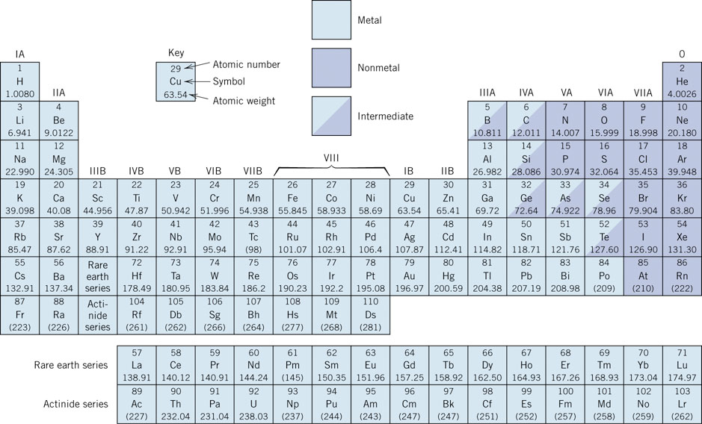
Recapitulate the Periodic Table from the book

Slide 15
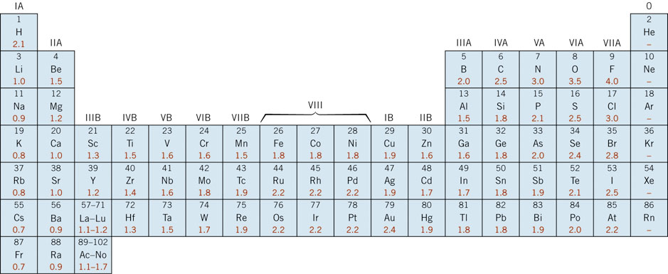
Recapitulate the Periodic Table from the book
Electro-negativity
Atoms are more likely to accept electrons if their outer shells are almost full, and if they are less “shielded” from (i.e., closer to) the nucleus

Slide 16
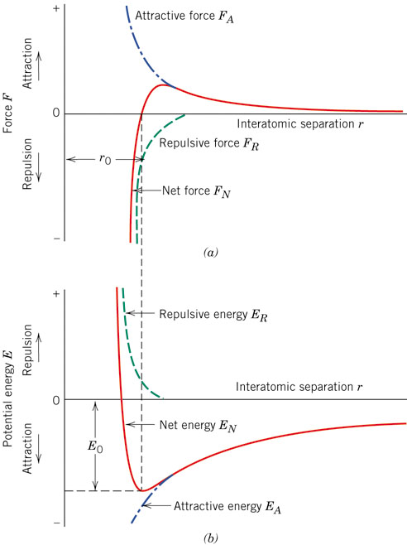
Bonding Force and Energies
E₀, Shape of the curve =
f(material, type of atomic bonding)
Properties: L/S/G; Melting Point, Modulus of elasticity, Coeff. Of thermal expansion
Bonding Energy: E₀

Slide 17
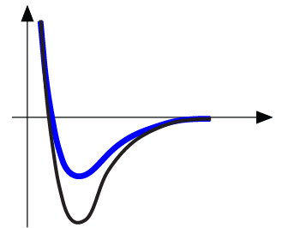
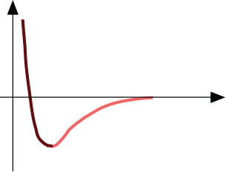
Properties From Bonding: T_{m}
• Bond length, r
• Melting Temperature, T_{m}
Energy
r
• Bond energy, E_{o}
r
o
r
Energy
smaller T_{m}
unstretched length
larger T_{m}
r
o
r
E_{o}
=
T_{m} is larger if E_{o} is larger.
“bond energy”

Slide 18
Properties From Bonding : α
• Coefficient of thermal expansion, α
length,
L
o
coeff. thermal expansion
unheated, T
1
Δ
L
Δ
L
=
α
(
T
-
T
)
L
2
1
heated, T
2
o
• α ~ symmetry at r_{o}
Energy
unstretched length
r
o
r
α is larger if E_{o} is smaller.
higher α
E_{o}
E_{o}
lower α

Slide 19
Atomic Bonding
Primary
Covalent
sharing electrons
strong
directional
Ionic
trading of elecrons
electrostatic attraction
strong
non-directional
Metallic
metal ions in sea or electrons
moderately strong
non-directional
Nature of the bonds = f (Electron structure of constituent atoms)
Atoms want to assume stable electronic structure

Slide 20
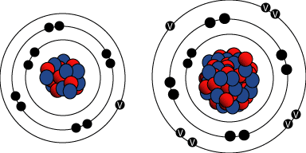
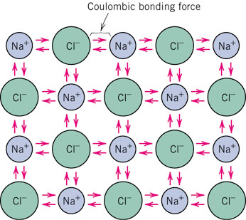
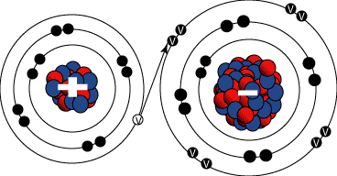
f09_02_pg27
IONIC BONDING
Hard, Brittle, Insulators
Ionic
trading of electrons
electrostatic Columbic attraction
Strong: Large bonding energy: between 600 – 1500 kJ/mole
non-directional
Notes:
f09_02_pg27.jpg

Slide 21
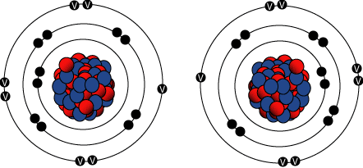
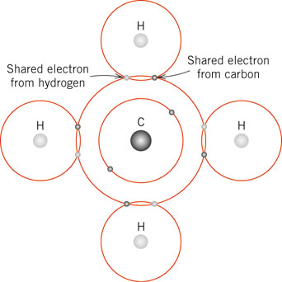
f10_02_pg28
COVALENT BONDING
Covalent
sharing electrons
Strong (Diamond) or weak (Bi)
directional
H₂, Cl₂, F₂
CH₄, H₂0, HNO₃, HF
Diamond, Si, Ge
GaAs, SiC
Notes:
f10_02_pg28.jpg

Slide 22

Primary Bonding
Ionic-Covalent Mixed Bonding
% ionic character =
where X_{A} & X_{B} are Pauling electronegativities
x
(
100
%)
Ex: MgO X_{Mg} = 1.3 X_{O} = 3.5

Slide 23
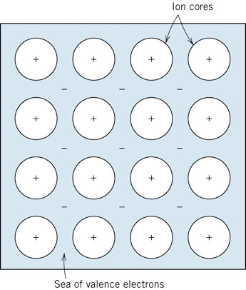
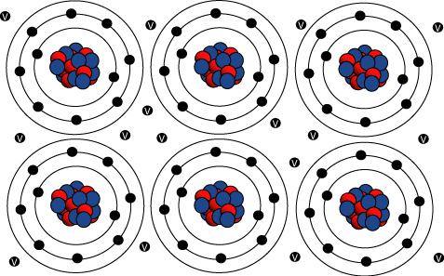
f11_02_pg30
METALLIC BONDING
Metallic
metal ions in sea of electrons
moderately strong
68 kJ/mole – 850 kJ/mole
non-directional
Good conductors of heat and electricity,
Ductile behavior
Notes:
f11_02_pg30.jpg

Slide 24
Secondary, Van der Waals, Physical bonds
Arise from electrostatic attraction of electric dipole (local charge distribution)
Weak 10 kJ/mole
Effects obscured if primary bonds are present
Occur between
Induced dipoles
Induced dipoles and polar molecules
Polar molecules (Hydrogen Bonding)

Slide 25
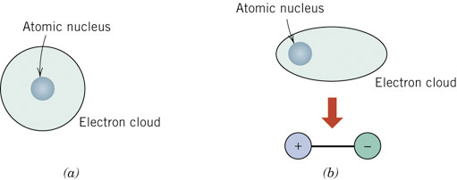
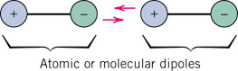
f13_02_pg31
Fluctuating Induced Dipole bonds
Vibrational motion of atoms
Instantaneous Short lived distortion of electrical symmetry
Attractive forces are temporary and fluctuate with time
_{H2, Cl2}
Notes:
f13_02_pg31.jpg

Slide 26
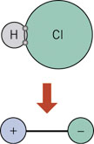
f14_02_pg32
Polar Molecule - Induced Dipole bonds
In polar molecules: Permanent dipole moment exists as a result of asymmetrical arrangements of +vely and –vely charged atoms
Polar molecules can induce dipoles in adjacent nonpolar molecules
Attractive forces between polar molecule and induced dipole --> bond will form
Energy greater than that between two fluctuating induced dipoles
Notes:
f14_02_pg32.jpg

Slide 27
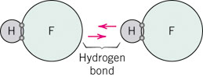
f14_02_pg32
Permanent Dipole bonds
Van der Waals forces between adjacent polar molecules
Bond energy is significantly greater than that of between induced dipoles
Example of polar molecule bonding: Hydrogen bonding (strongest secondary bonding)
Occurs when hydrogen is covalently bonded to F, O, N
Single H electro is shared by other atom → H end of the bond is essentially a +vely charged bare proton that is unscreened by any electrons
Bond energy can be as high as 51 kJ/mole
Low molecular weight , However MP and BP very high
Notes:
f14_02_pg32.jpg

Slide 28
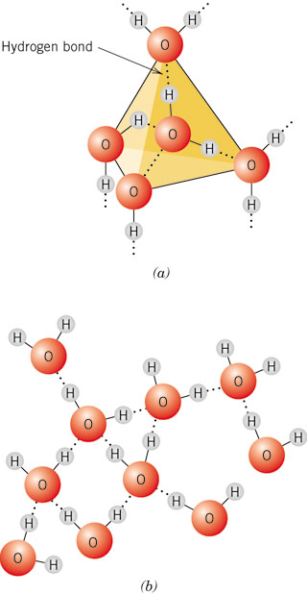
f16_02_pg33
Water: Volume expansion upon freezing!!
9 volume % expansion upon freezing
Solid ice structure
Liquid water
Each water molecule participates in 4 hydrogen bonds →
Has 4 nearest neighbours
Open structure
Lower density
Melting
Structure partially broken – Molecules more closely packed together
Average number of nearest neighbours = 4.5
Notes:
f16_02_pg33.jpg

Slide 29
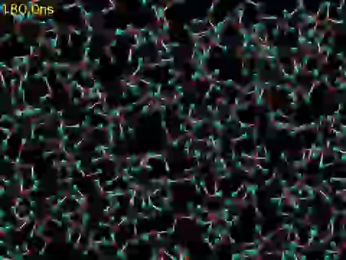
Water freezing into ice, by computer simulation. M. Matsumoto, S. Saito, and I. Ohmine, Molecular dynamics simulation of the ice nucleation and growth process leading to water freezing, Nature 416, 409-413 (2002)

Slide 30
Summary
Subatomic (electronic) structure,
Periodic table,
Bond energy,
Inter-atomic/molecular bonding = f (electronic str.),
Primary
Metallic
Ionic
Covalent
Secondary
Effects of sub-atomic structure and bonding on properties

Slide 31
Students’ Presentations list
Sl. No. of allotment | Topic | Names | Roll
1 | Composite materials for aircraft (Topic 4) | Kailash Hudda | 16ME10031
 |  | Marghoob Kaifi | 16ME10041
 |  | Subodh Jain | 16ME10062
2 | Materials Damage in Nuclear Power Plant (Topic 6) | Ritvik Pandey | 16me30032
 |  | Ashwin Nehete | 16mf10035
 |  | Koumudi Mantha | 16me3fp07
3 | Ti Alloy for aerospace application (Topic 1) | Neelanjan Akuli | 16ME30049
 |  | Anjali Rao | 16MF3IM04
 |  | R Amartya | 16MF10034
4 | Ti alloy for biomaterial application (Topic 2) | PRAJWAL | 16ME30050
 |  | Siddhartha kapuria | 16ME30052
 |  | Akshay Jain | 16MF3IM02
5 | Ni based superalloy for gas turbine application (Topic 3) | Sangam | 16MF10023
 |  | Amit Pandey | 16ME10072
 |  | Shashwat Dixit | 16MF10032
6 | Metal Foams – Their Properties and Applications (Topic 5) | Debmalya Roy | 16ME10018
 |  | Debapriya De | 16ME10017
 |  | Jyotirmay Sahoo | 16ME10030

